Slide 1
Cross Platform Application Development Assignment-1 (Simple Chat App) Group 10
Benny Thomas: 2020sp93040
Lovish Mehta: 2020sp93008
Siddhant Tripathi: 2020sp93081
Indrajeet Mahanta: 2020sp93014

Slide 2
INTRODUCTION
Chat application using Flutter.
Users can login using google sign in.
Anyone who joins the application can see everyone who has joined and can initiate chat(Any of the above functionality can be changed if deemed unfeasible to implement).
Users can upload images if required.

Slide 3
TECH STACK
Front End:
Flutter - an open-source UI software development kit created by Google which is used to develop cross platform applications for Android, iOS, Linux, Mac, Windows and the web from a single codebase
Backend:
Firebase - Google Firebase is a Google-backed application development software that enables developers to develop iOS, Android and Web apps. Firebase provides tools for tracking analytics, reporting and fixing app crashes, creating marketing and product experiment.
Deployment:
Currently we plan to deploy our application on Android and localhost/iOS (will take decision later).

Slide 4
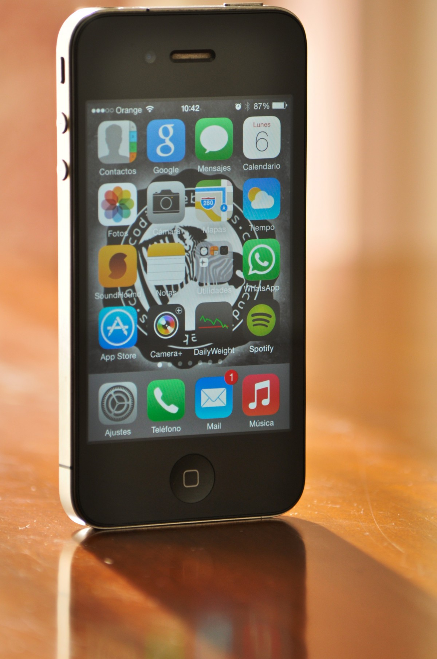
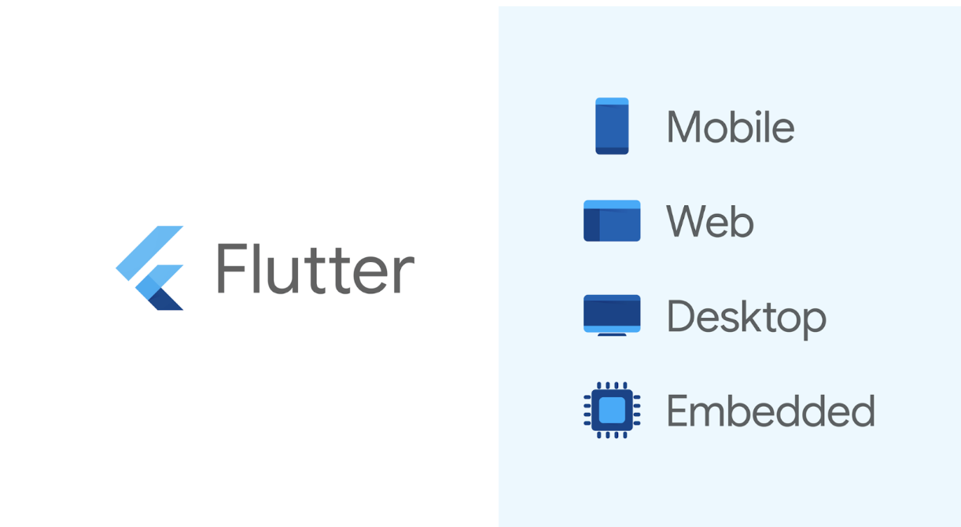

FLOW OF CONTROL
Android/Web/iOS
(Will decide later)
This Photo by Unknown Author is licensed under CC BY-NC-ND
This Photo by Unknown Author is licensed under CC BY

Slide 5
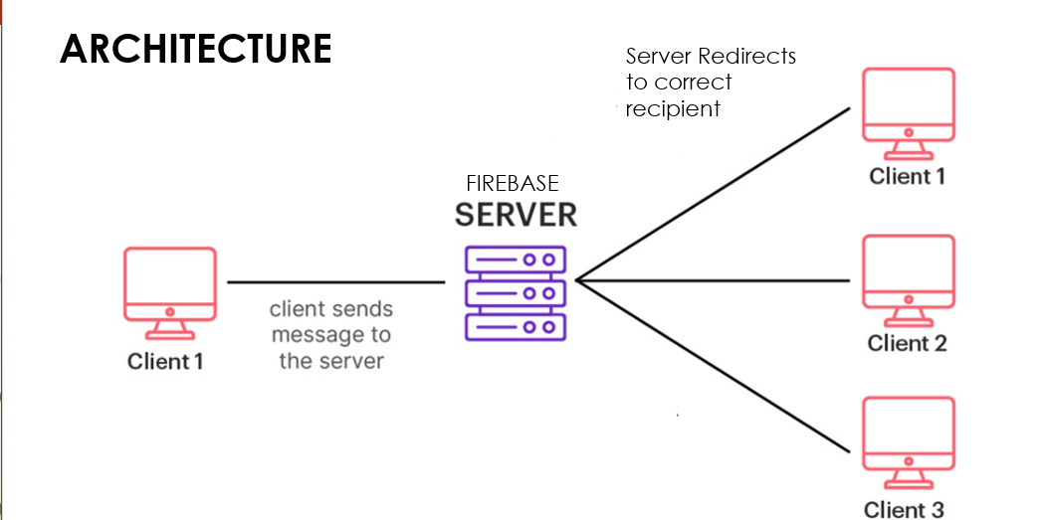

Slide 6
THANK YOU

